Slide 1
Calculating a Sample Size

Slide 2
Sample Accuracy
Sample accuracy: refers to how close a random sample’s statistic (e.g. mean, variance, proportion) is to the population’s value it represents (mean, variance, proportion)
Important points:
Sample size is NOT related to representativeness … you could sample 20,000 persons walking by a street corner and the results would still not represent the city; however, an n of 100 could be “right on.”
Sample size, however, IS related to accuracy. How close the sample statistic is to the actual population parameter (e.g. sample mean vs. population mean) is a function of sample size.

Slide 3
Sample Size AXIOMS
To properly understand how to determine sample size, it helps to understand the following AXIOMS…

Slide 4
Sample Size Axioms
The only perfectly accurate sample is a census.
A probability sample will always have some inaccuracy (sample error).
The larger a probability sample is, the more accurate it is (less sample error).
Probability sample accuracy (error) can be calculated with a simple formula, and expressed as a + % value.

Slide 5
Sample Size Axioms…cont.
You can take any finding in the survey, replicate the survey with the same probability sample plan & size, and you will be “very likely” to find the same result within the + range of the original findings.
In almost all cases, the accuracy (sample error) of a probability sample is independent of the size of the population.

Slide 6
Sample Size Axioms…cont.
A probability sample can be a very tiny percentage of the population size and still be very accurate (have little sample error).
The size of the probability sample depends on the client’s desired accuracy (acceptable sample error) balanced against the cost of data collection for that sample size.

Slide 7
There is only one method of determining sample size that allows the researcher to PREDETERMINE the accuracy of the sample results…
The Confidence Interval Method of Determining Sample Size

Slide 8
The Confidence Interval Method of Determining Sample Size
Notion of Confidence Interval
Confidence interval: range whose endpoints define a certain percentage of the responses to a question
Central limit theorem: a theory that holds that values taken from repeated samples of a survey within a population would look like a normal curve. The mean of all sample means is the mean of the population.

Slide 9
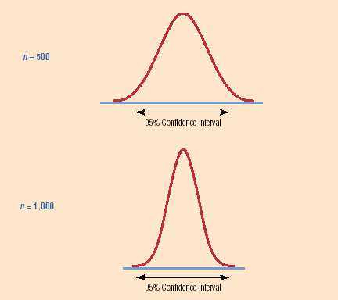
We know that, given the amount of variability in the population, the sample size affects the size of the confidence interval; as n goes down the interval widens (more “sloppy”)

Slide 10
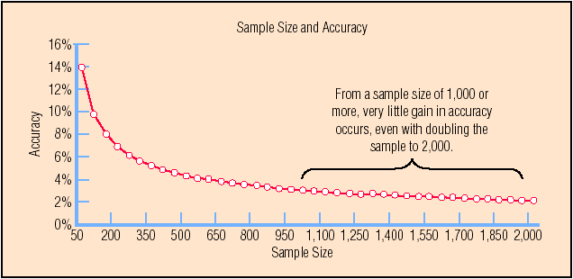
The Confidence Interval Method of Determining Sample Size
The relationship between sample size and sample error:

Slide 11
2 Formulas
One for when you’re looking for a proportional answer (e.g. for/against)
One for when you’re looking for a mean (e.g. the average age of a county’s voters)
This is also called Point Estimation

Slide 12
The Confidence Interval Method of Determining Sample Size - Proportions
Variability
Variability: refers to how similar or dissimilar responses are to a given question
P (%): share that “have” or “are” or “will do” etc.
Q (%): 100%-P%, share of “have nots” or “are nots” or “won’t dos” etc.
N.B.: The more variability in the population being studied, the larger the sample size needed to achieve stated accuracy level.

Slide 13
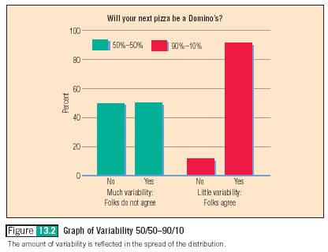
With Nominal data (i.e. Yes, No), we can conceptualize answer variability with bar charts…the highest variability is 50/50

Slide 14
So, what have we learned thus far?
There is a relationship among:
the level of confidence we desire that our results be repeated within some known range if we were to conduct the study again, and…
the variability (in responses) in the population and…
the amount of acceptable sample error (desired accuracy) we wish to have and…
the size of the sample.

Slide 15
Sample Size Formula
The formula requires that we (a.)specify the amount of confidence we wish to have, (b.) estimate the variance in the population, and (c.) specify the level of desired accuracy we want.
When we specify the above, the formula tells us what sample size we need to use….n

Slide 16
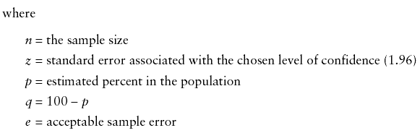
Sample Size Formula - Proportion
The sample size formula for estimating a proportion (also called a percentage or share):

Slide 17
Practical Considerations in Sample Size Determination
How to estimate variability (p and q shares) in the population
Expect the worst case (p=50%; q=50%)
Estimate variability: results of previous studies or conduct a pilot study

Slide 18
Practical Considerations in Sample Size Determination
How to determine the amount of desired sample error
Researchers should work with managers to make this decision. How much error is the manager willing to tolerate (less error = more accuracy)?
Convention is + 5%
The more important the decision, the less should be the acceptable level of the sample error

Slide 19
Practical Considerations in Sample Size Determination
How to decide on the level of confidence desired
Researchers should work with clients to make this decision. The higher the desired confidence level, the larger the sample size needed
Convention is 95% confidence level (z=1.96 which is + 1.96 s.d.’s )
The more important the decision, the more likely the manager will want more confidence. For example, a 99% confidence level has a z=2.58.

Slide 20
Example: Estimating a Percentage (proportion or share) in the Population What is the Required Sample Size?
Five years ago a survey showed that 42% of client’s were aware of the agency’s services (Clients were either “aware” or “not aware”)
After an intense public information campaign, management will conduct another survey. They want to be 95% confident (95 chances in 100) that the survey estimate will be within + 5% of the true share of “aware” consumers in the population.
What is n?

Slide 21
Estimating a Percentage: What is n?
Z=1.96 (95% confidence)
p=42% (p, q and e must be in the same units)
q=100% - p%=58%
e= + 5%
What is n?

Slide 22
N=374 What does this mean?
It means that if we use a sample size of 374, after the survey, we can say the following of the results: (Assume results show that 55% are aware)
“Our most likely estimate of the percentage of consumers that are “aware” of our brand name is 55%. In addition, we are 95% confident that the true share of “aware” customers in the population falls between 52.25% and 57.75%.”
Note that: ( + .05 x 55% = + 2.75%) !!!!

Slide 23
Task
Figure out how big the sample should be for 95% confidence in the Simple Random Sample example handout
400

Slide 24
Estimating a Mean This requires a different formula
Sample size formula for a mean
Z is determined the same way (1.96 or 2.58)
e is expressed in terms of the units we are estimating, i.e. if we are
measuring attitudes on a 1-7 scale, we may want our error to be
no more than + .5 scale units. If we are estimating dollars being paid for a product, we may want our error to be no more than + $3.00.
S is a little more difficult to estimate, but must be in same units as e.

Slide 25
Estimating “s” in the Formula to Determine the Sample Size Required to Estimate a Mean
Since we are estimating a mean, we can assume that our data are either interval or ratio. When we have interval or ratio data, the standard deviation of the sample, s, may be used as a measure of variance.
How to estimate s?
Use standard deviation of the sample from a previous study on the target population
Conduct a pilot study of a few members of the target population and calculate s
Loose rule of thumb, s=Range/4

Slide 26
Example: Estimating the Mean of a Population What is the required sample size, n?
Sample size formula for a mean
Management wants to know clients’ level of satisfaction with their service. They propose conducting a survey and asking for satisfaction on a scale from 1 to 10 (since there are 10 possible answers, the range = 10).
Management wants to be 99% confident in the results (99 chances in 100 that true value is captured) and they do not want the allowed error to be more than + .5 scale points.
What is n?

Slide 27
What is n?
Sample size formula for a mean
S = 1.7 (from a pilot study), Z = 2.58 (99% confidence), and
e = .5 scale points
What is n? It is 77. Assume the survey average score was 7.3, what does this “tell us?” A 10 is very satisfied and a 1 is not satisfied at all.
Answer: “Our most likely estimate of the level of consumer satisfaction is 7.3 on a 10-point scale. In addition, we are 99% confident that the true level of satisfaction in our consumer population falls between 6.8 and 7.8 on the scale.”

Slide 28
Go back and look at Disproportionate Stratified Sampling example handout
What types of questions would being asked?
Would some be proportional, others point estimates?
Might you need different formulas?

Slide 29
What about Small Populations?
Why does a small population matter?
What kind of sampling is it? With or without replacement? Ever play Blackjack?
Anything south of 100,000, the numbers begin to change
However, they only begin to REALLY change south of 5000
A population less than 5000 is VERY COMMON in our line of work!
We need the Population Correction Factor!

Slide 30
Formulas with PCF
Point Estimation
Proportion Estimation

Slide 31
Other Methods of Sample Size Determination
Arbitrary “percentage rule of thumb” sample size:
Arbitrary sample size approaches rely on erroneous rules of thumb (e.g. “n must be at least 5% of the population”).
Arbitrary sample sizes are simple and easy to apply, but they are neither efficient nor economical. (e.g. Using the “5 percent rule,” if the universe is 12 million, n = 600,000 – a very large and costly result)

Slide 32
Other Methods of Sample Size Determination…cont.
Conventional sample size specification
Conventional approach follows some “convention” or number believed somehow to be the right sample size (e.g. 1,000 – 1,200 used for national opinion polls w/+ 3% error)
Using conventional sample size can result in a sample that may be too large or too small.
Conventional sample sizes ignore the special circumstances of the survey at hand.

Slide 33
Other Methods of Sample Size Determination…cont.
Statistical analysis requirements of sample size specification
Sometimes the researcher’s desire to use particular statistical technique influences sample size. As cross comparisons go up cell sizes go up and n goes up.
Cost basis of sample size specification
Using the “all you can afford” method, instead of the value of the information to be gained from the survey being the primary consideration in sample size determination, the sample size is based on budget factors.

Slide 34
Special Sample Size Determination Situations
Sample Size Using Nonprobability Sampling
When using nonprobability sampling, sample size is unrelated to accuracy, so cost-benefit considerations must be used

